Slide 1
Inverse Parametric Sequence Alignment
J. Algorithms, Vol. 53, No. 1, pp. 36-54, 2004
Reporter: Chiou-Ting Tseng
Date: Dec. 28, 2006

Slide 2
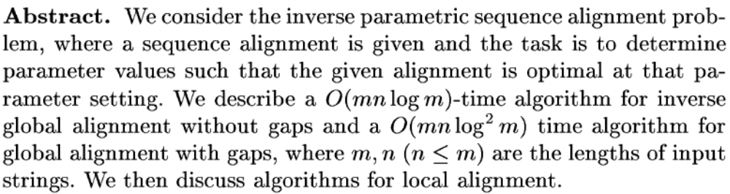
Abstract

Slide 3
Parametric Optimization of Sequence Alignment
D. Gusfield, K. Balasubramanian, and D. Naor
Proceedings of the third annual ACM-SIAM symposium on Discrete algorithms, pp. 432-439, 1992

Slide 4
Parametric Sequence Alignment
The parametric sequence alignment problem is to compute optimal alignments for two fixed sequences as a function of varying penalties.
Ex. AAA and BBBB
AAA-
BBBB
indel=-3
mismatch=-1
AAA----
---BBBB
indel=-1
mismatch=-3

Slide 5
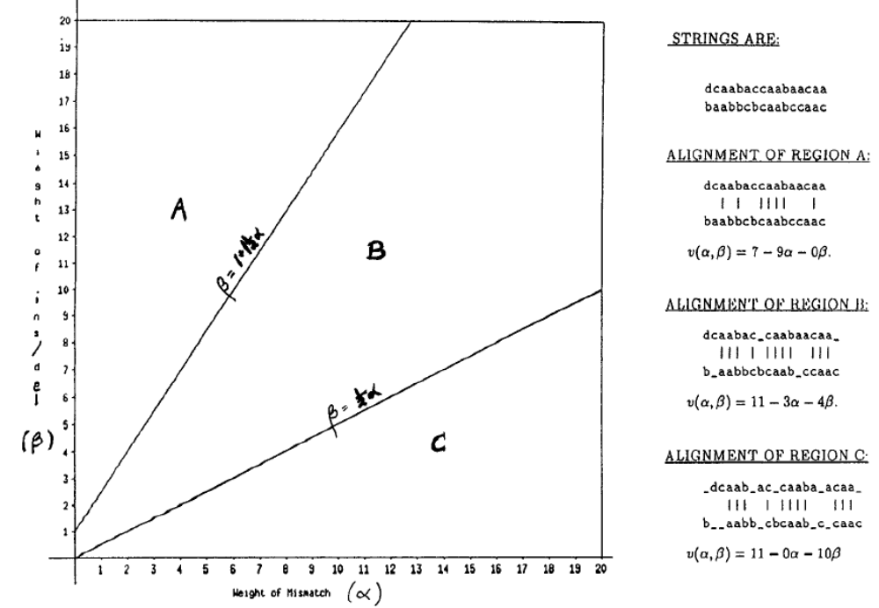

Slide 6
Scoring Function
v=w-αx-βy-γz
v: score
w, x, y, z: number of match, mismatch, indel, gap
α, β, γ: penalties of mismatch, indel, gap normalized to match score.

Slide 7
Result
If gap is ignored, in the global alignment, the number of convex polygons in the decomposition is bounded by n^{2/3}. Each boundary line are of the form β=c+(c+0.5)α

Slide 8
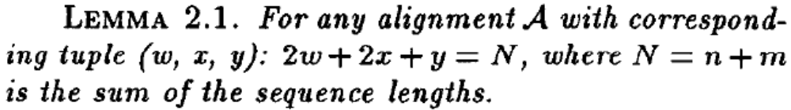

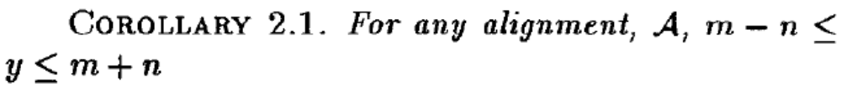
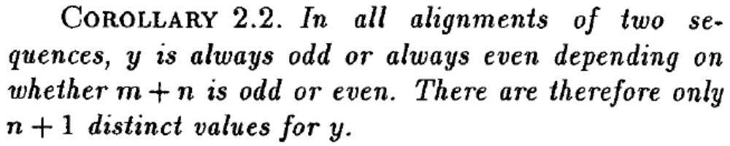
Lemma

Slide 9
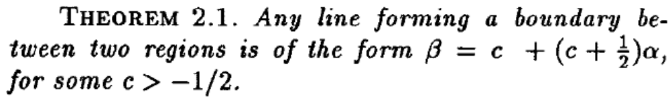
Theorem
v=w-αx-βy
(m+n)/2=w+x+(y/2)
so all planes must meet at (-1, -0.5)
let β=c+c₁α → β=c+(c+0.5)α

Slide 10

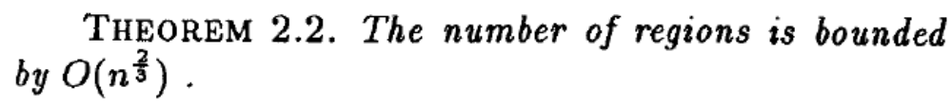
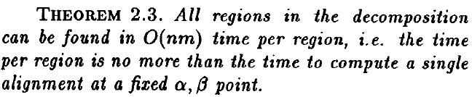
Lemma
Eisner-Severance method
O(n^{5/3}m) time

Slide 11
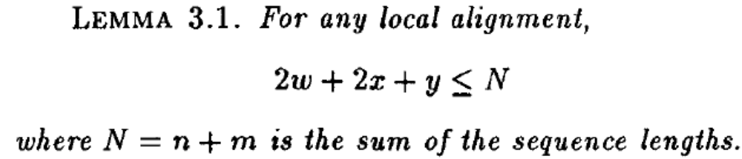
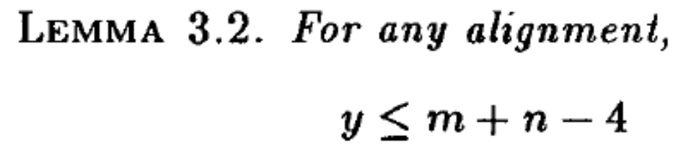
Local Parametric Alignment
O(n³m) time

Slide 12
Unstated Content
Global alignment with gap.
  β=c+(c+0.5)α, γ=d+ dα.
Local Alignment with gap.
Richer weight and penalties.

Slide 13
Inverse Parametric Sequence Alignment
The inverse parametric sequence alignment problem is to find parameter values such that reference alignment is optimal for those values or, if no such settings exist, find a parameter setting minimizing the numerical difference between the score of the optimal alignment and the score of the reference alignment.

Slide 14
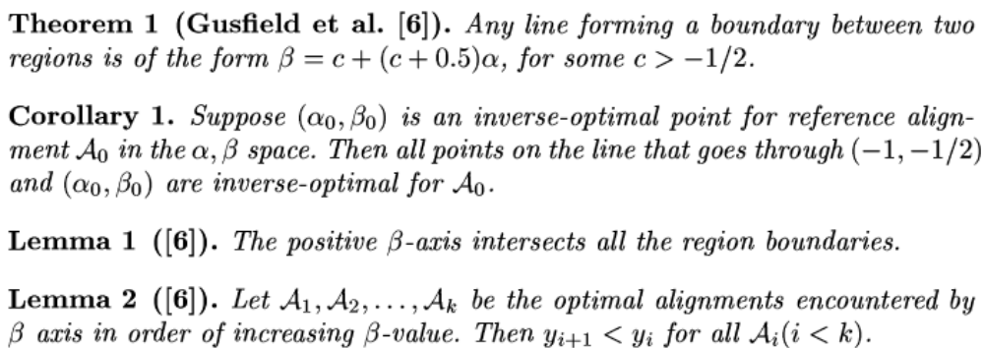
Global Alignment without Gaps

Slide 15
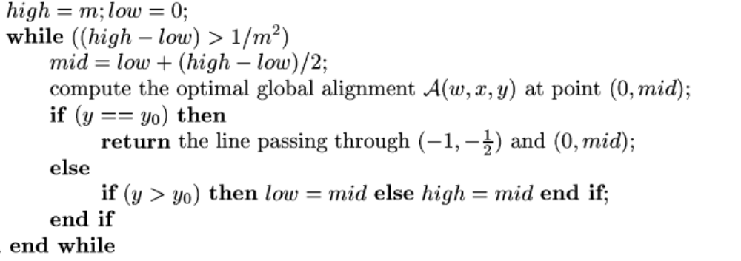
Global Alignment without Gaps

Slide 16
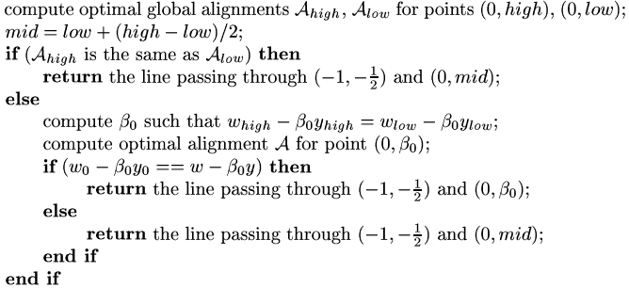
Global Alignment without Gaps

Slide 17
Omitted Content
Global Alignment with Gaps.
  O(mnlog²m) time
Local alignment without gap
  O(mnlog²m) time

